Slide 1

UE21CS461A – Capstone Project Phase – 2
Project Progress Review # 1
Project Title : Personal AI Stylist
Project ID : PW24_RR_03
Project Guide : Dr. Roopa Ravish
Project Team : Niel Abhishek J David [PES1UG22CS820]
Nisha E [PES1UG22CS822]
Monisha S [PES2UG22CS809]
Vishwas Vivian Anthony [PES1UG22CS852]

Slide 2
Outline
Abstract and Scope of the Project
Capstone Project Phase – 1
Summary of work
Inferences drawn from Literature Survey
List of Tasks/Modules with Individual Contribution
Design of overall Architecture
Demonstration and Testing of the completed modules.
Gantt chart

Slide 3
Issues faced by customers
Common Issues Faced by Customers when shopping online:
Wrong Size: Hard to find the right fit, leading to returns.
• Uncertain Style: Not sure how clothes will look on you.
• Quality Unknown: Can't tell quality and material online.
• Not My Fit: No consideration for individual body types and skin tones.
• Generic Recs: Product suggestions don't match personal style.

Slide 4
Introduction
Introduction
The fashion industry is changing. People want a more personal and easy way to find clothes that fit their style and body. Traditional methods can be time-consuming and frustrating.
Our project aims to :
Use Artificial Intelligence to understand individual fashion preferences
Provide personalized clothing recommendations
Allow virtual try-on and easy shopping
Make fashion more enjoyable and accessible for everyone

Slide 5
Abstract
Personal AI Stylist
What We Offer:
• Get Your Perfect Fit: Our system analyzes your body type using images.
• Your Style, Your Way: We learn your preferences and suggest clothes just for you.
• Try Before You Buy: Virtually try on clothes for a fun experience.
Our Goal:
• Confident Fashion Choices: Help you make stylish decisions with ease.
• Solve the Outfit Puzzle: Find the perfect outfit, every time!

Slide 6
Scope
Scope:
Create Your Feed: Make your own personalized newsfeed.
Style Suggestions: Get outfit recommendations just for you.
Virtual Try-On: See how clothes look on you using AR.
Improve Recommendations: Give feedback to make suggestions better.
E commerce API: Get real-time data on clothing items: + Description + Prices + Stock availability

Slide 7
How we try to overcome these issues
How Our Personal AI Stylist Helps
• Get the Right Fit: Our AI measures your body type to suggest perfect sizes.
• Your Personal Style: We consider your style, likes, and body type to give you tailored advice.
• Try Before You Buy: See how clothes look on you virtually before buying.
• Look Your Best: We consider your body type to suggest flattering clothes.
• Get Better Results: Our AI learns from your feedback to give you more accurate suggestions over time.

Slide 8
Benefits
Benefits of the Personal AI Stylist
Increased Customer Satisfaction: Personalized recommendations lead to higher customer satisfaction and loyalty
Reduced Returns and Exchanges: Accurate size and fit recommendations reduce the need for returns and exchanges
Enhanced User Experience: Virtual try-on and personalized styling create an engaging and enjoyable shopping experience

Slide 9
Literature Survey
Our Project | Existing Research
Body Shape Prediction: Predicts body shape by processing user images directly, using advanced computer vision techniques. | Body Shape Prediction: Often relies on body measurement calculators or manual input for body shape prediction, which can be less intuitive.
Integration with Retailers: Direct integration with Amazon API for real-time data on clothing items, including prices and stock availability. | Integration with Retailers: Most studies focus on recommendation frameworks without direct integration with retail platforms.
Virtual Try-On Feature: Incorporates AR-based virtual try-on for users to visualize clothing on their bodies. | Virtual Try-On Feature: Some papers discuss 3D body shape estimation, but AR-based virtual try-on is not a focus.
Comprehensive User Profile Management: Allows users to create profiles, input preferences, and continuously improve recommendations through feedback. | Comprehensive User Profile Management: Focuses more on the recommendation algorithms and less on user profile management.
Cross-Platform Support: Designed for both Android and iOS, with a cloud-based backend. | Cross-Platform Support: Primarily focused on theoretical frameworks or web-based implementations
.​

Slide 10
Improvements
Focus mainly on Western Styles
Virtual Try-On
Age-Specific Recommendations
Tailored for Women
Real-Time Shopping Integration
Simplified Body Shape Analysis

Slide 11
List of Tasks/Modules
List of Tasks
User Authentication
User Profiling
Body Type Analysis
Virtual Try On
Dashboard (homepage)
Trend Analysis and Style Preferences
Categories

Slide 12
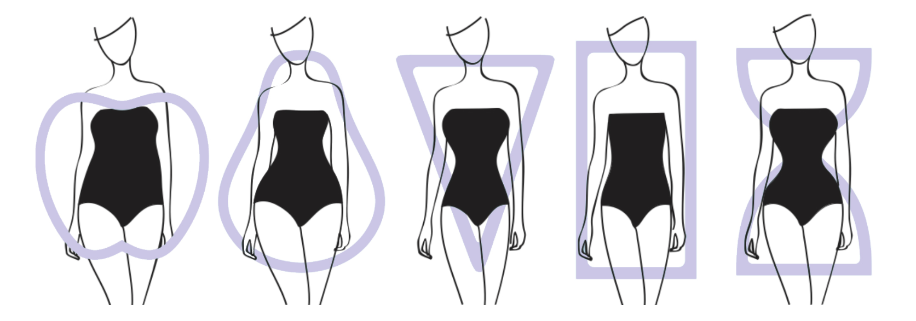
Body Type Analysis
Data Collection & Preparation
Apple
Hourglass
Inverted Triangle
Peer

Slide 13
Body Type Analysis
Preprocessing Steps:
Duplicate Removal: All duplicate images were identified and removed.
File Type Filtering: Only .jpg and .png images were retained; other file formats were excluded.
Organizing the Data: The cleaned data was organized into respective folders for each body type.

Slide 14
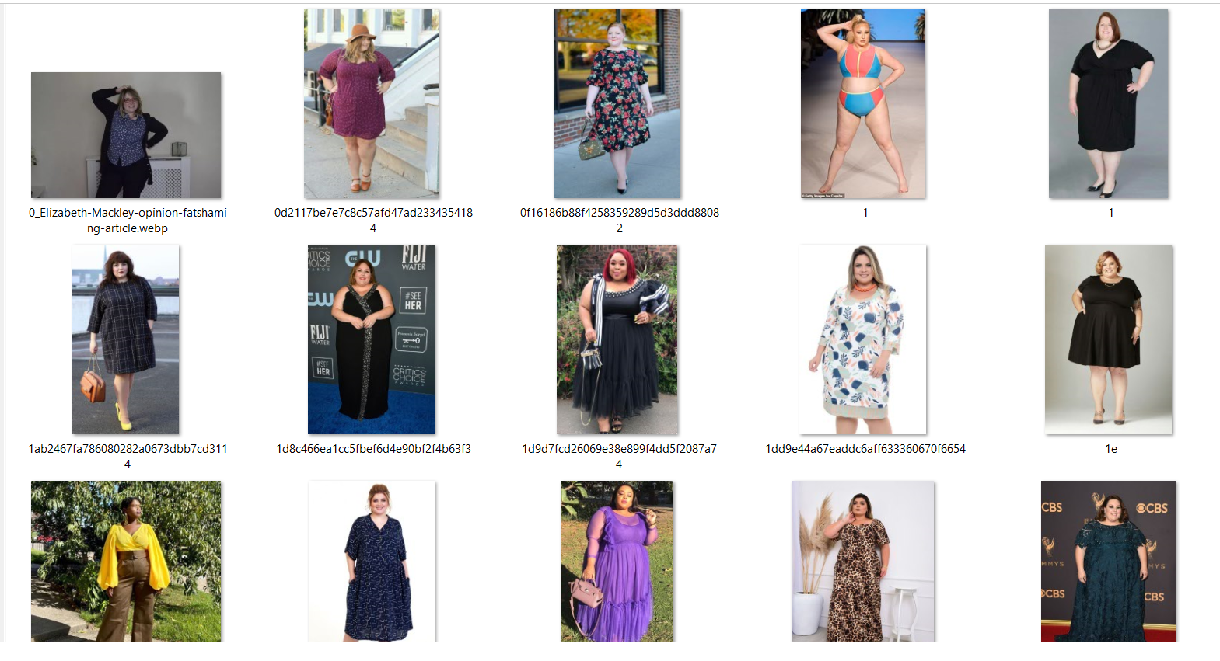
3 Data input Apple Body Shape

Slide 15
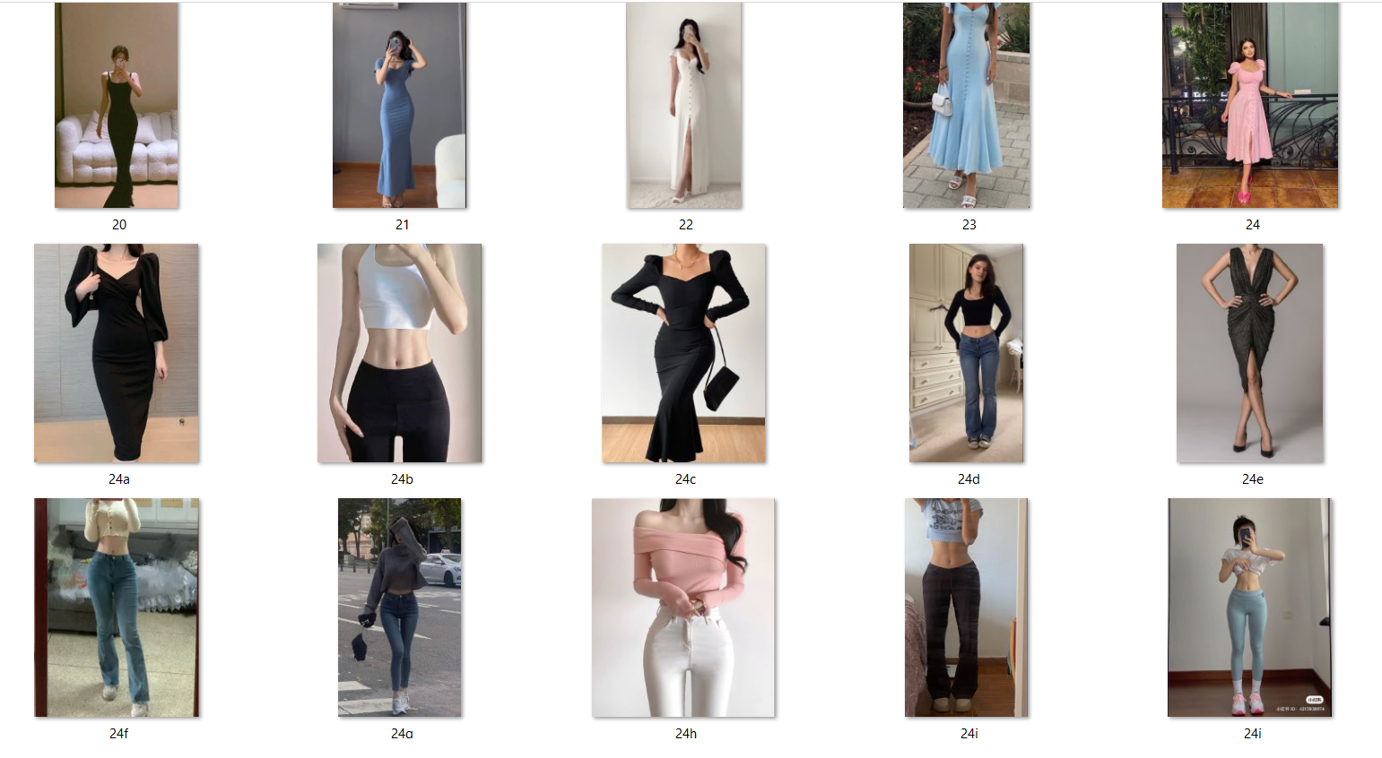
Hourglass Body Shape

Slide 16
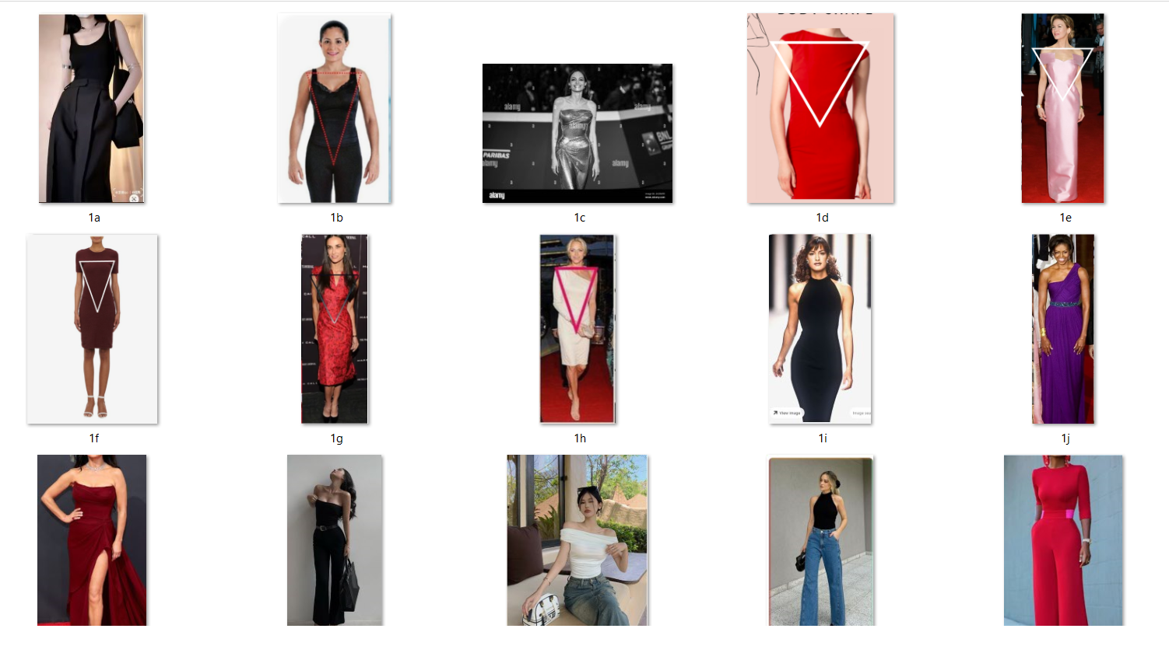
Inverted Triangle Body Shape

Slide 17
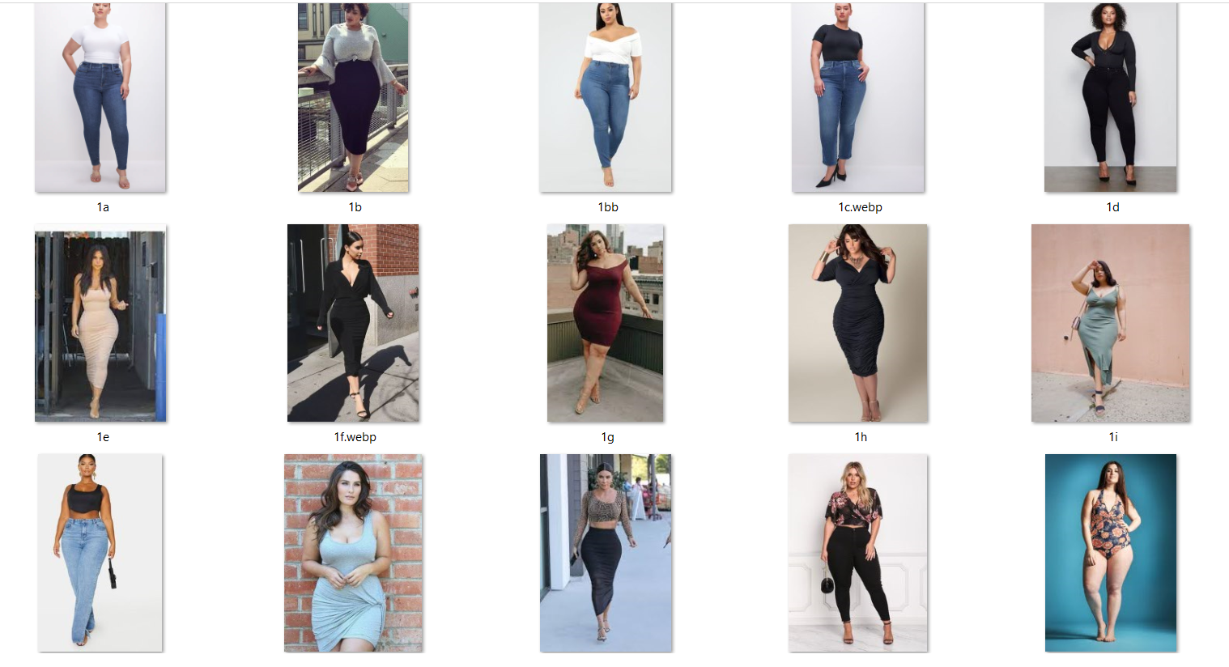
Peer Body Shape

Slide 18
Body Type Analysis
Machine Learning Models:
Random Forest
VGG16
DenseNet201
Xception
InceptionV3
EfficientNet80

Slide 19
Body Type Analysis
4. Data Visualization
Tools Used:
Matplotlib: Customizable 2D plotting
Seaborn: Enhanced statistical visualizations
Key Visualizations:
Confusion Matrix: Displayed using Seaborn, this heatmap helps in understanding model performance by showing the number of correct and incorrect predictions for each class.
Cross-Validation Scores: Visualized as bar plots or line graphs to compare model performance across different folds.

Slide 20
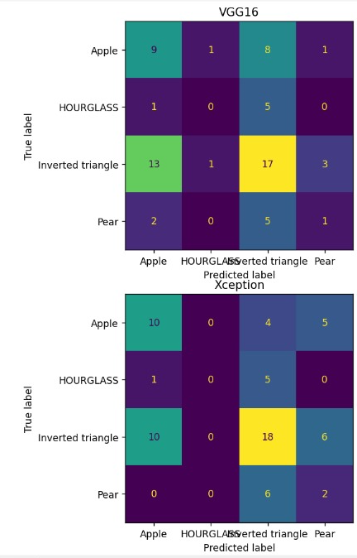
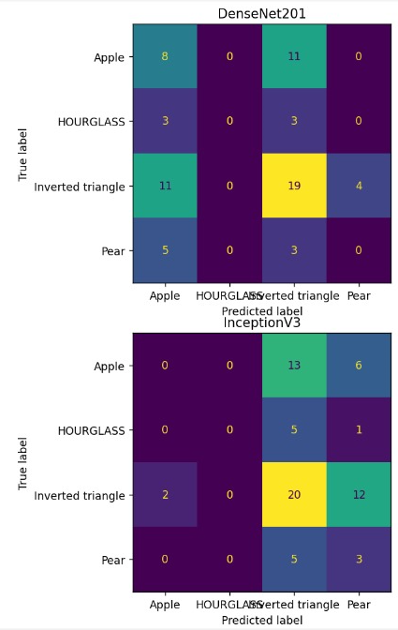
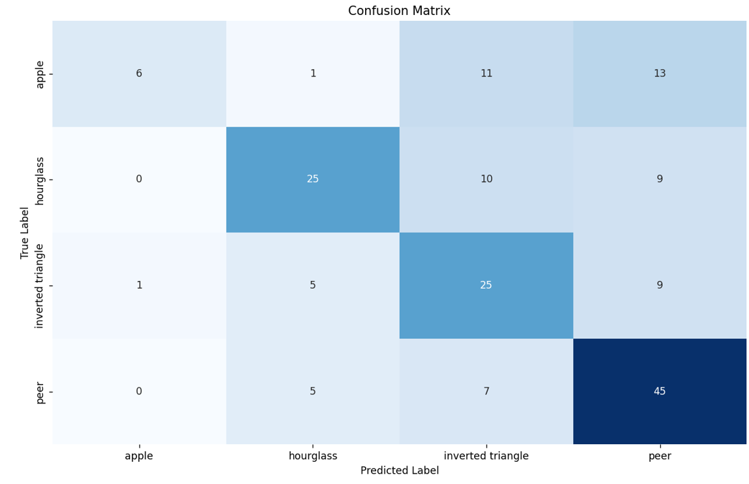
Body Type Analysis
Training Validation and Confusion Matrix
Random Forest

Slide 21
Body Type Analysis
5. Data Interpretation
Understanding Model Outputs:
Confusion matrices for classification performance
ROC curves for evaluating model discrimination
Precision-Recall curves for imbalanced data
Insights Gained:
Identification of key features influencing model predictions
Adjustments in data preprocessing based on outlier detection
Refinement of models for better accuracy

Slide 22
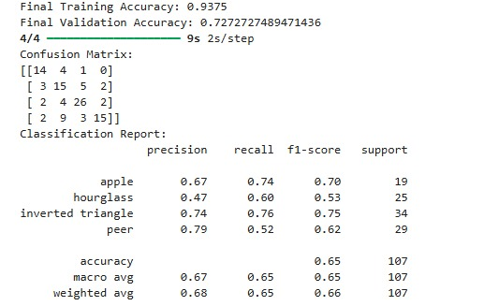
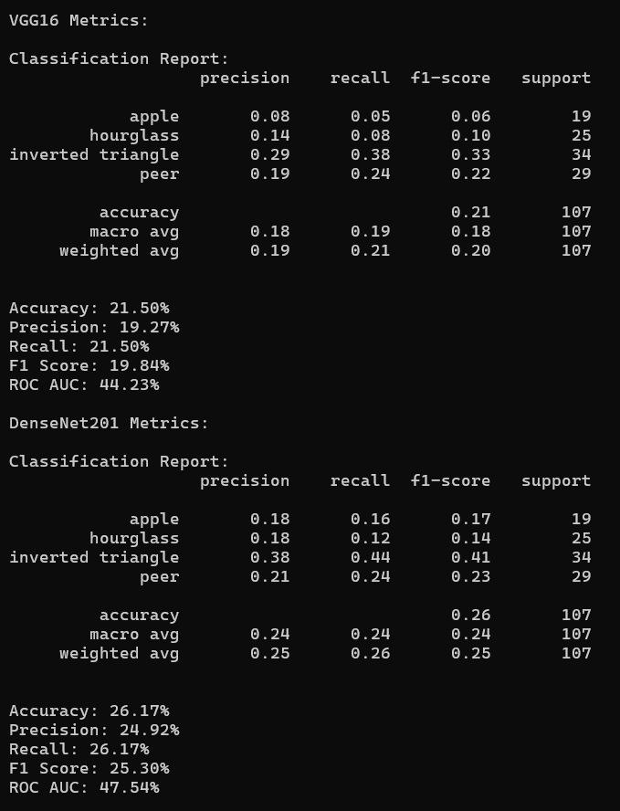
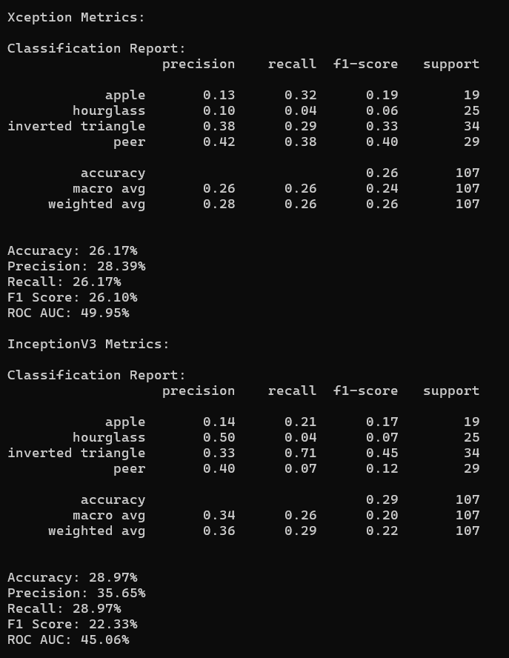
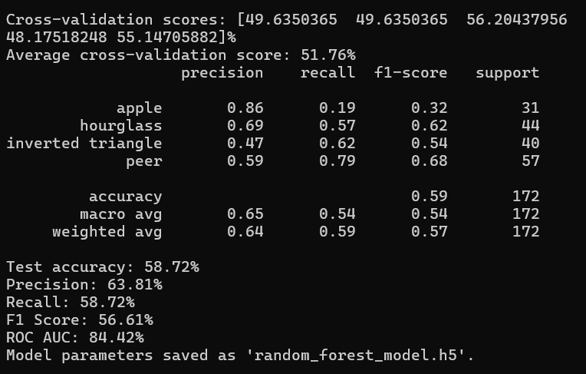
Body Type Analysis
Model Training and Evaluation
Random Forest

Slide 23
Body Type Analysis
Optimizers:
Adam Optimizer
Learning Rate Tuning
Hyperparameter Tuning
Model Saving:
File formats: “.h5” for TensorFlow, “.pkl” for Random Forest
Compatibility with mobile platforms – “.tflite” for Android)

Slide 24
Body Type Analysis
6. Storage
Currently, all data and models are stored locally on the system

Slide 25
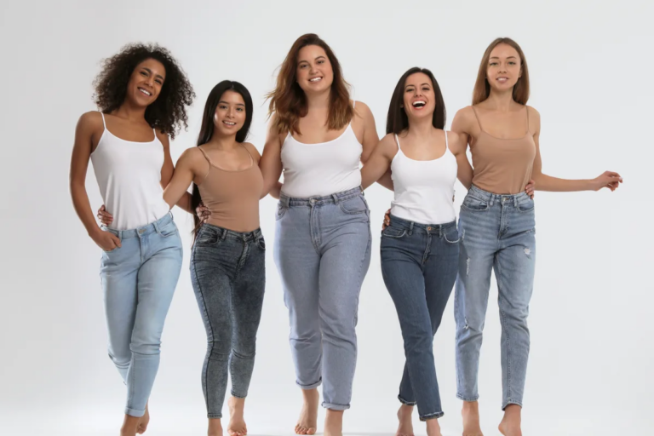
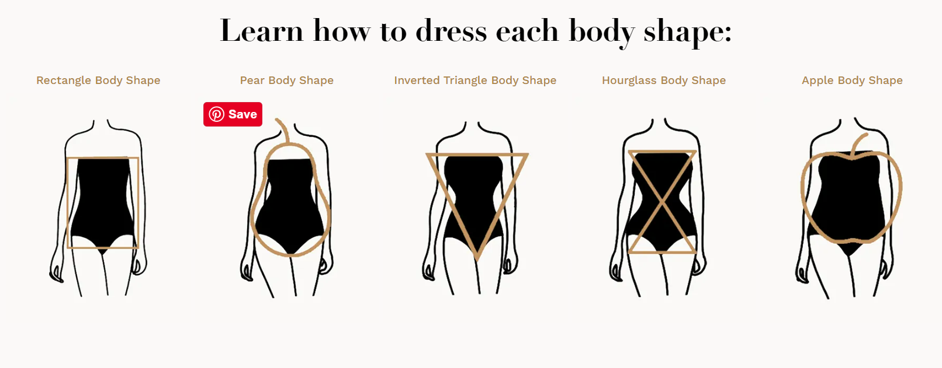
Mapping Clothing Pattern to Body Type
Our goal is to map specific clothing patterns to different body types to provide personalized fashion recommendations.
Step 1: Understanding Different Body Types .
Inverted Triangle: Broader shoulders, narrower hips.
Pear: Wider hips and thighs, smaller waist and bust.
Hourglass: Balanced figure with a defined waist, full bust, and hips.
Apple: Larger midsection, narrower hips, and legs.

Slide 26
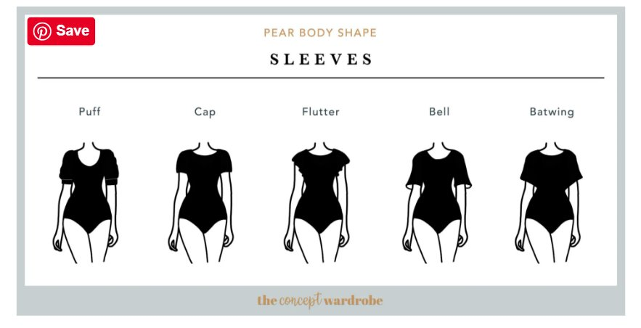
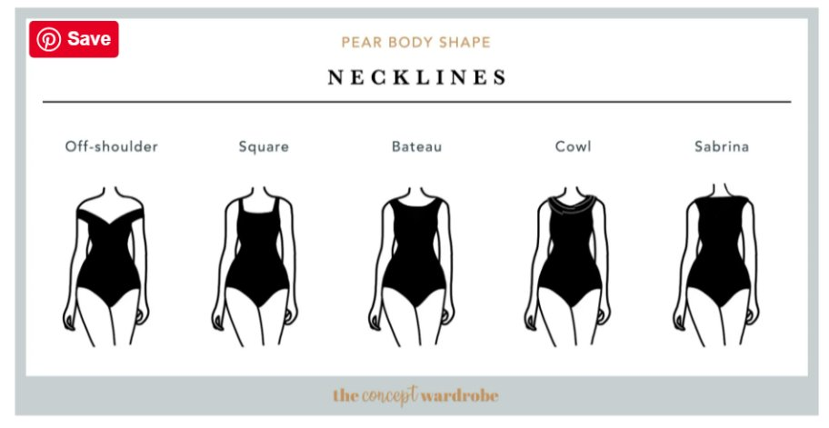
Mapping Clothing Pattern to Body Type
Mapping Clothing Patterns
Peer

Slide 27
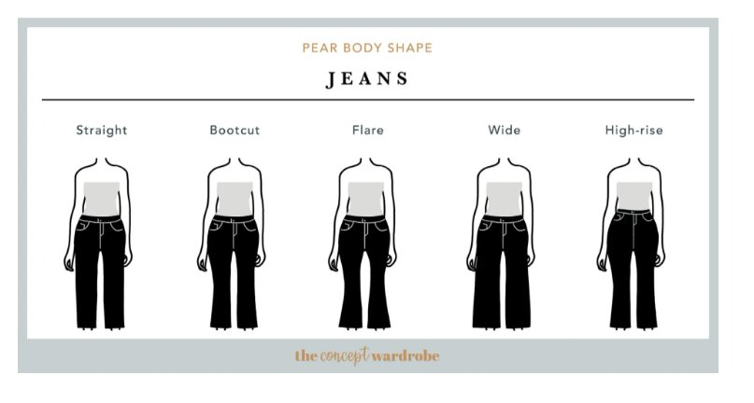
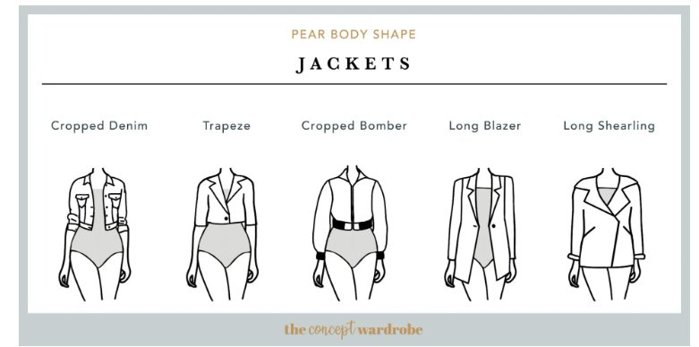
Mapping Clothing Pattern to Body Type
Mapping Clothing Patterns
Peer

Slide 28
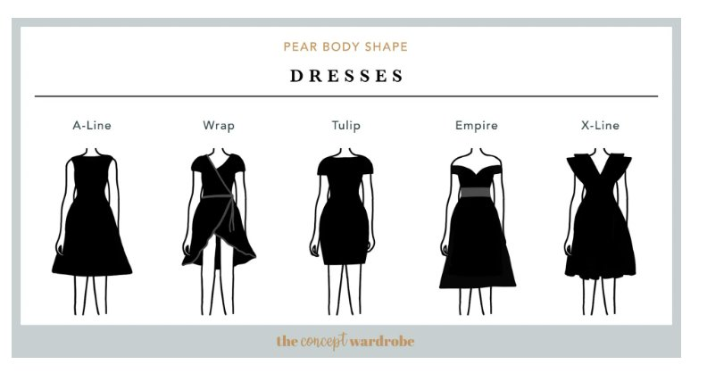
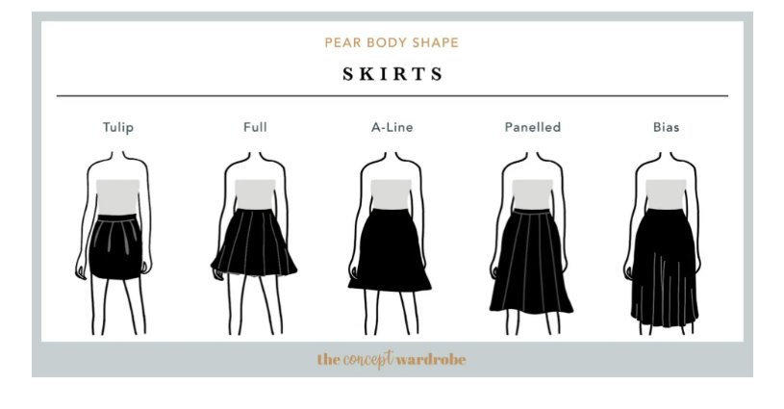
Mapping Clothing Pattern to Body Type
Mapping Clothing Patterns
Peer
https://theconceptwardrobe.com/build-a-wardrobe/pear-body-shape

Slide 29
Mapping Clothing Pattern to Body Type
Mapping Clothing Patterns
Peer
https://www.bewakoof.com/blog/dressing-for-your-body-shape/

Slide 30
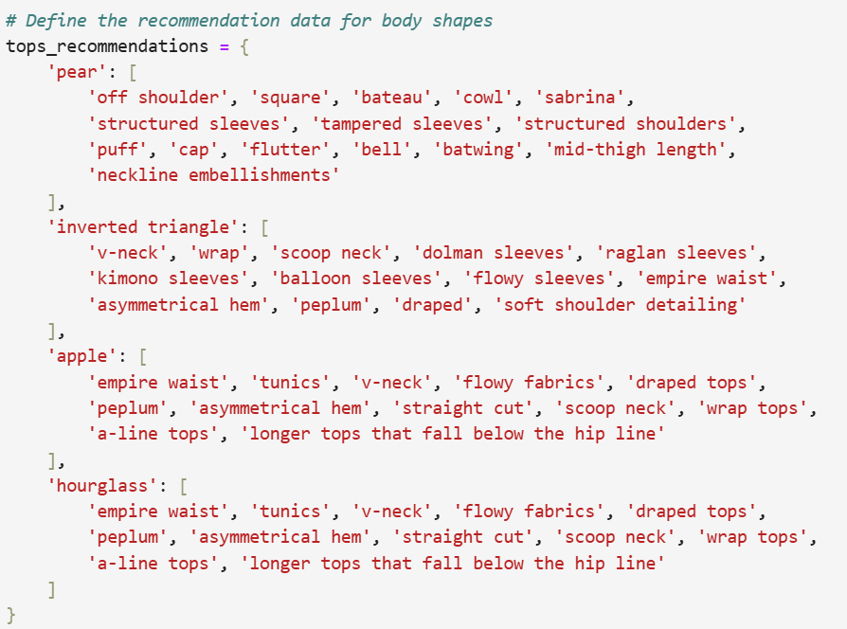
Mapping Clothing Pattern to Body Type
Mapping Clothing Patterns for [ Tops ]

Slide 31
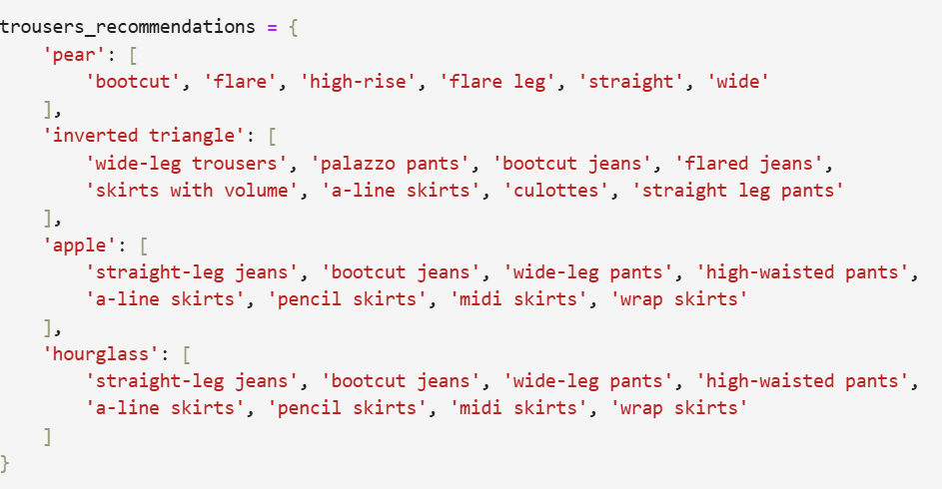
Mapping Clothing Pattern to Body Type
Mapping Clothing Patterns for [ Trousers ]

Slide 32
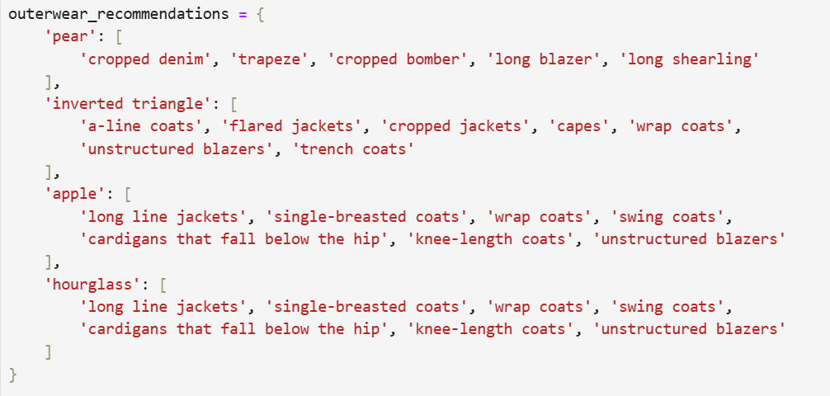
Mapping Clothing Pattern to Body Type
Mapping Clothing Patterns for [ Outwears ]

Slide 33
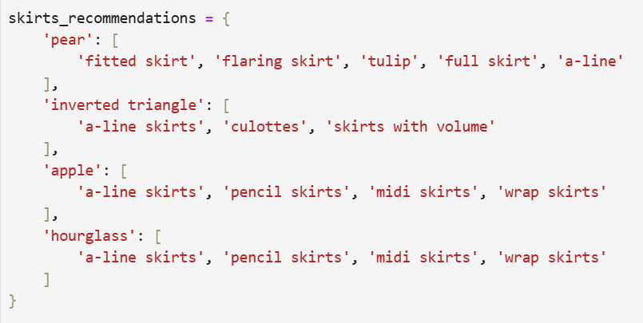
Mapping Clothing Pattern to Body Type
Mapping Clothing Patterns for [ Skirts ]

Slide 34
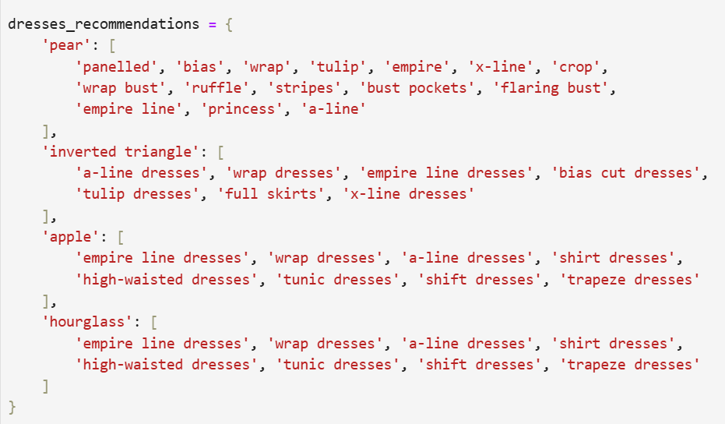
Mapping Clothing Pattern to Body Type
Mapping Clothing Patterns for [ Dresses ]

Slide 35
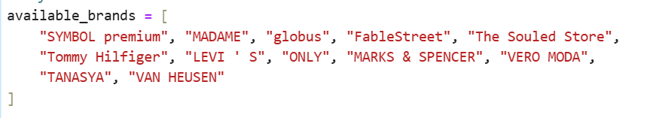
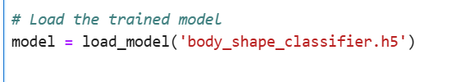
Mapping Clothing Pattern to Body Type
Defining available Brands in our API
Loading the trained body shape classification model

Slide 36
Mapping Clothing Pattern to Body Type
Defining available Brands in our API
Loading the trained body shape classification model

Slide 37
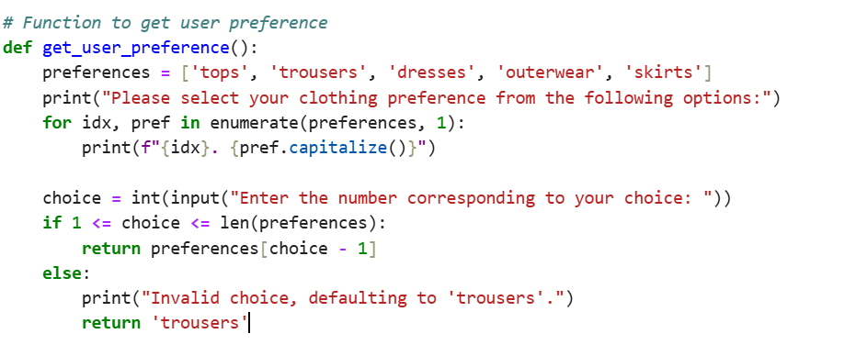
Mapping Clothing Pattern to Body Type
Function to get user preferences

Slide 38
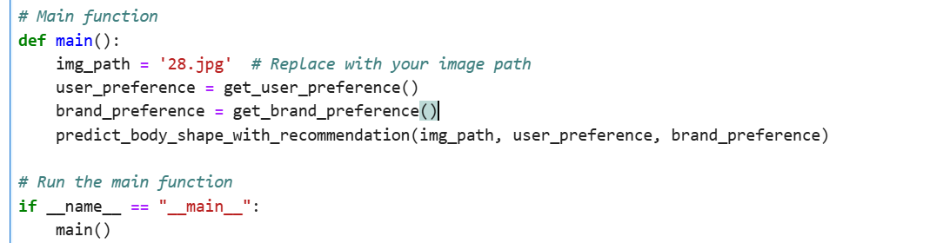
Mapping Clothing Pattern to Body Type
Main method

Slide 39
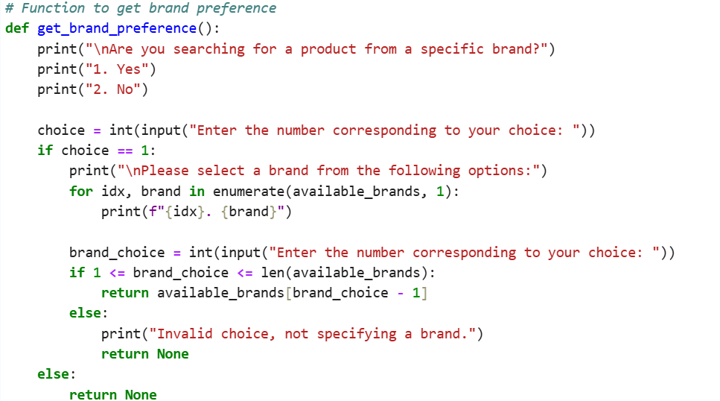
Mapping Clothing Pattern to Body Type
Function to get Brand preferences

Slide 40
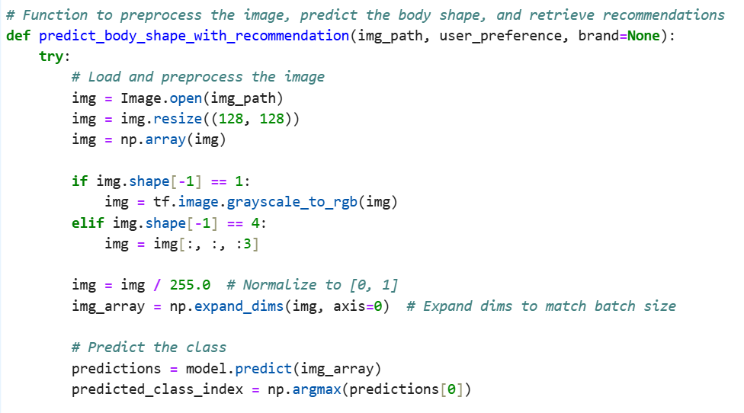
Mapping Clothing Pattern to Body Type
Image preprocessing and predicting body shape

Slide 41
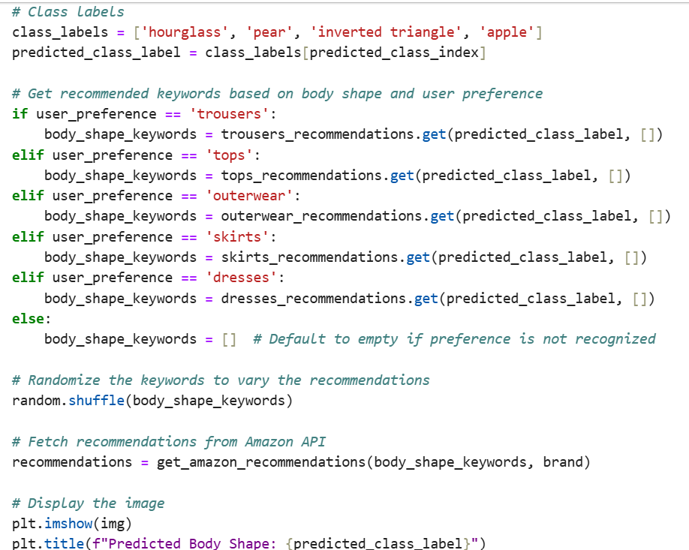
Mapping Clothing Pattern to Body Type
Taking user preferences as a parameter along with body type

Slide 42
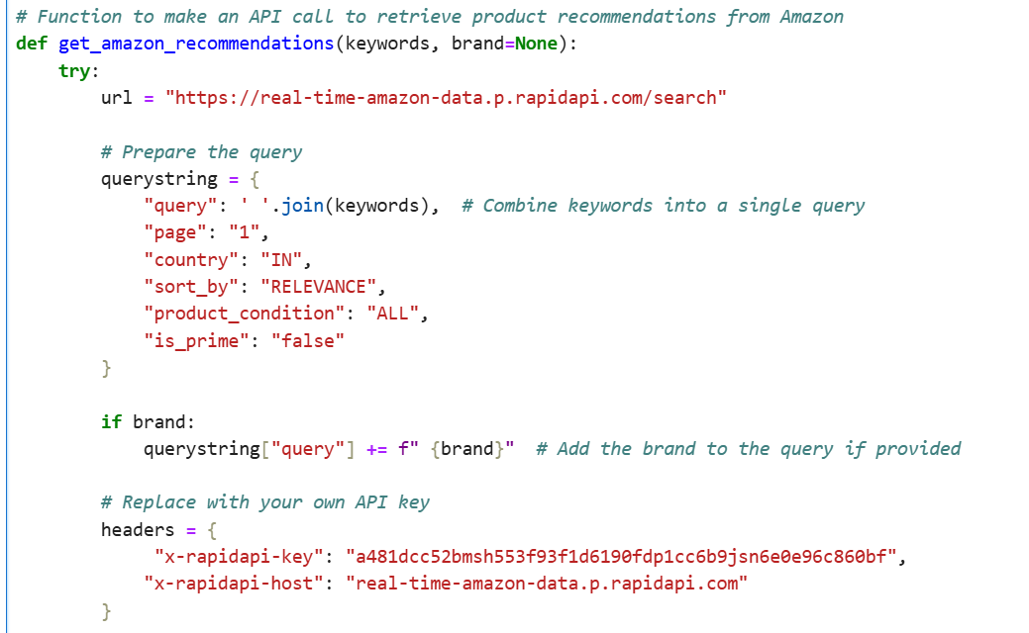
Mapping Clothing Pattern to Body Type
Function to make amazon API Call

Slide 43

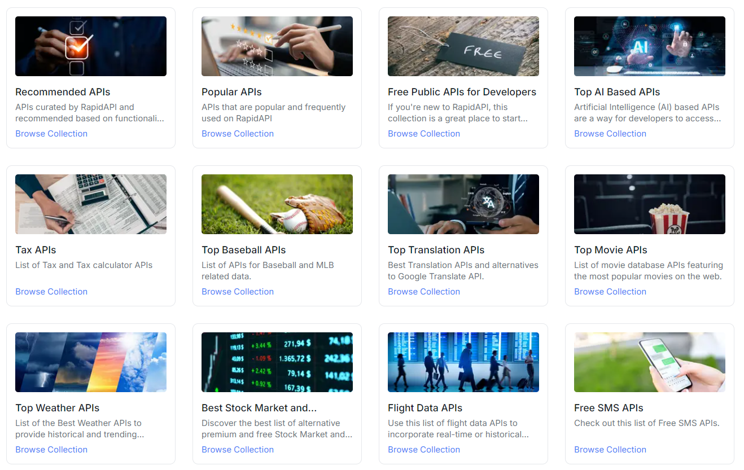
API

Slide 44



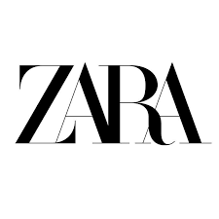


API
TOOLS

Slide 45
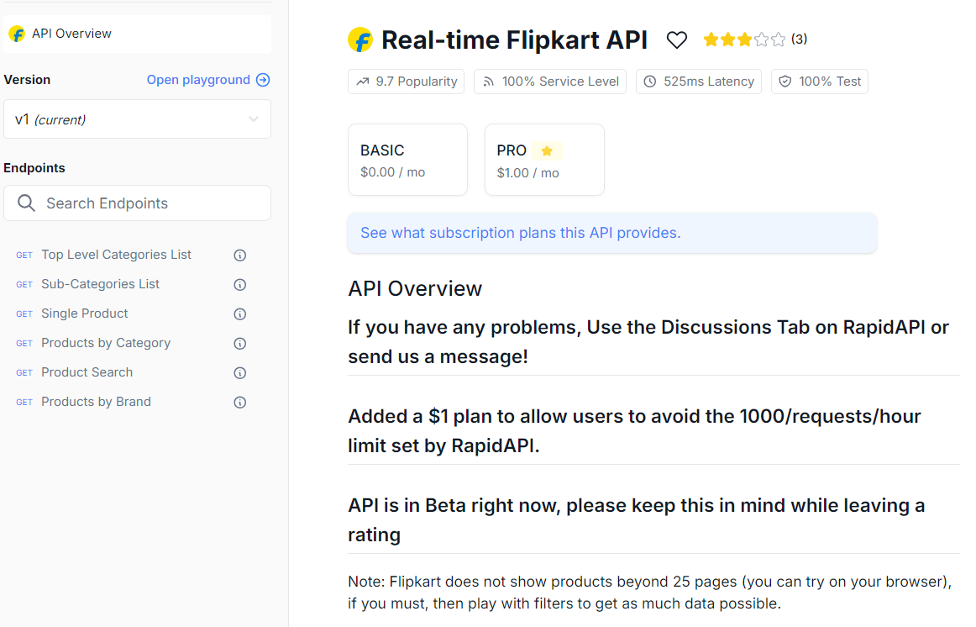

Slide 46
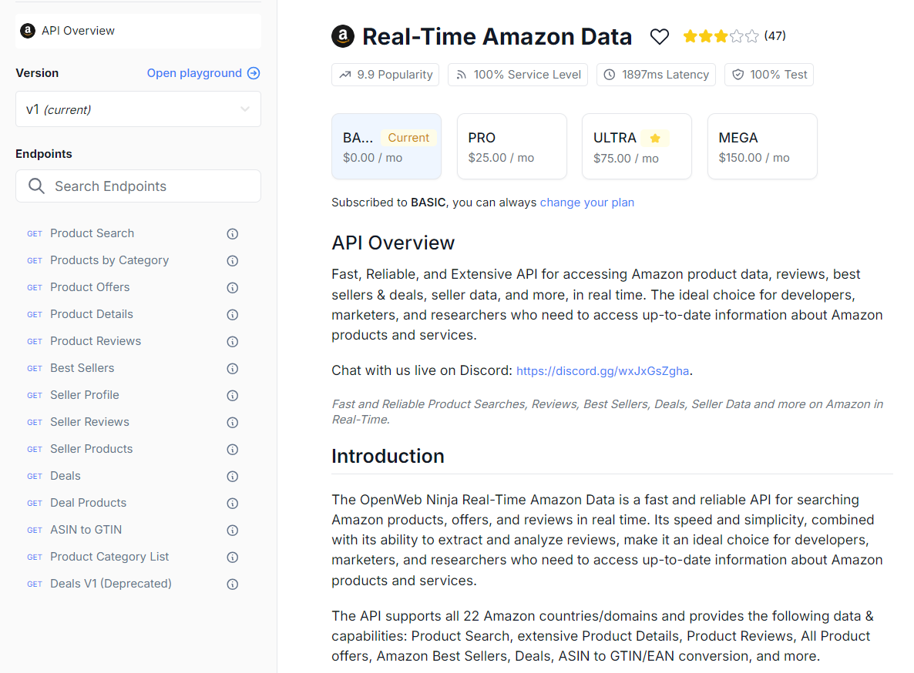

Slide 47
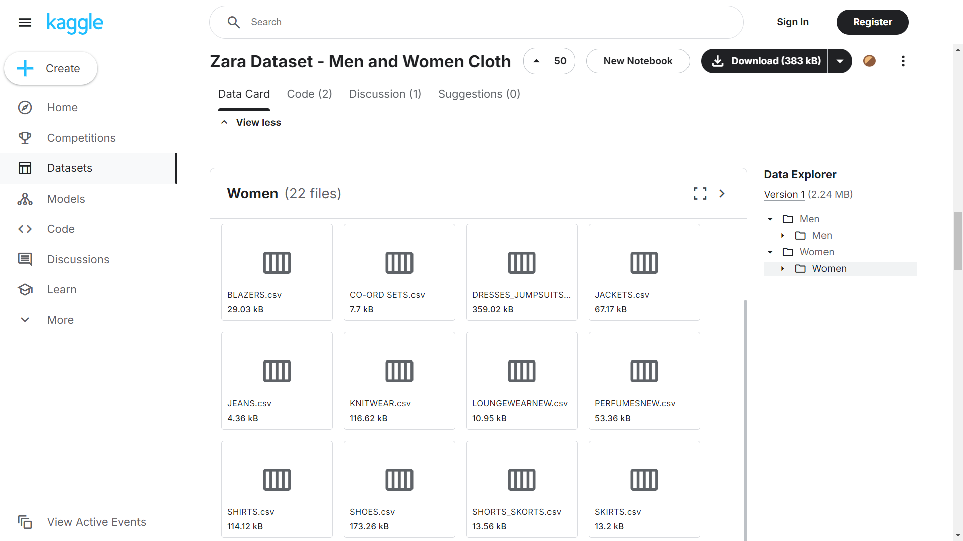

Slide 48
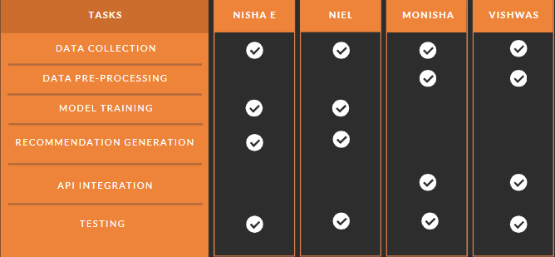
Individual Contribution

Slide 49
References
Dress With Style: Learning Style From Joint Deep Embedding of Clothing Styles and Body Shapes. Date of Publication: 12 March 2020 Publisher: IEEE
What Dress Fits Me Best?: Fashion Recommendation on the Clothing Style for Personal Body Shape Published:15 October 2018
Fashion Is Taking Shape: Understanding Clothing Preference Based on Body Shape From Online Sources 2019 IEEE Winter Conference Publisher: IEEE
Revolutionizing Fashion: Fashion Era’s Deep Convolutional Neural Network for Outfit Recommendations Submitted: 01/12/2023 Revised: 29/01/2024 Accepted: 03/02/2024
Fashion Is Taking Shape: Understanding Clothing Preference Based on Body Shape From Online Sources Publisher: IEEE
ViBE: Dressing for Diverse Body Shapes Wei-Lin Hsiao, Kristen Grauman; Proceedings of the IEEE/CVF Conference on Computer Vision and Pattern Recognition (CVPR), 2020, pp. 11059-11069
Mahir Jain, Suraj Singh, K. Chandrasekaran, M V Rathnamma, V. Venkata Ramana “Machine Learning Models with Optimization for Clothing Recommendation from Personal Wardrobe” 07-08 February 2020, (IEEE Conference Record # 48199)
Shaghayegh Shirkhani, Hamam Mokayed, Rajkumar Saini, Hum Yan Chai “Study of AI Driven Fashion Recommender Systems” 18 May 2023, (Springer link)

Slide 50
Thank You

